Slide 1
爱拼才会赢
No pain no gain
施晓蕙 Dana Shih

Slide 2
爱拼才会赢 = 加油！
ài pīn cái huì yíng

Slide 3
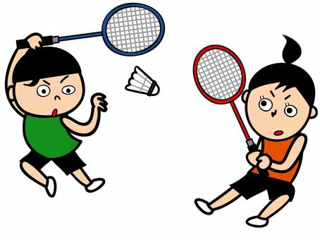
Circle “次” in the 林丹 text.
Then read it out loud.
cì
次
一次
第一次
第一次打羽毛球
一次
第一次
第一次成为世界冠军
Notes:
Need to add a few words of 次- 第一次，每一次，...etc

Slide 4
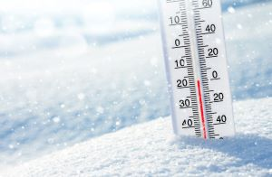
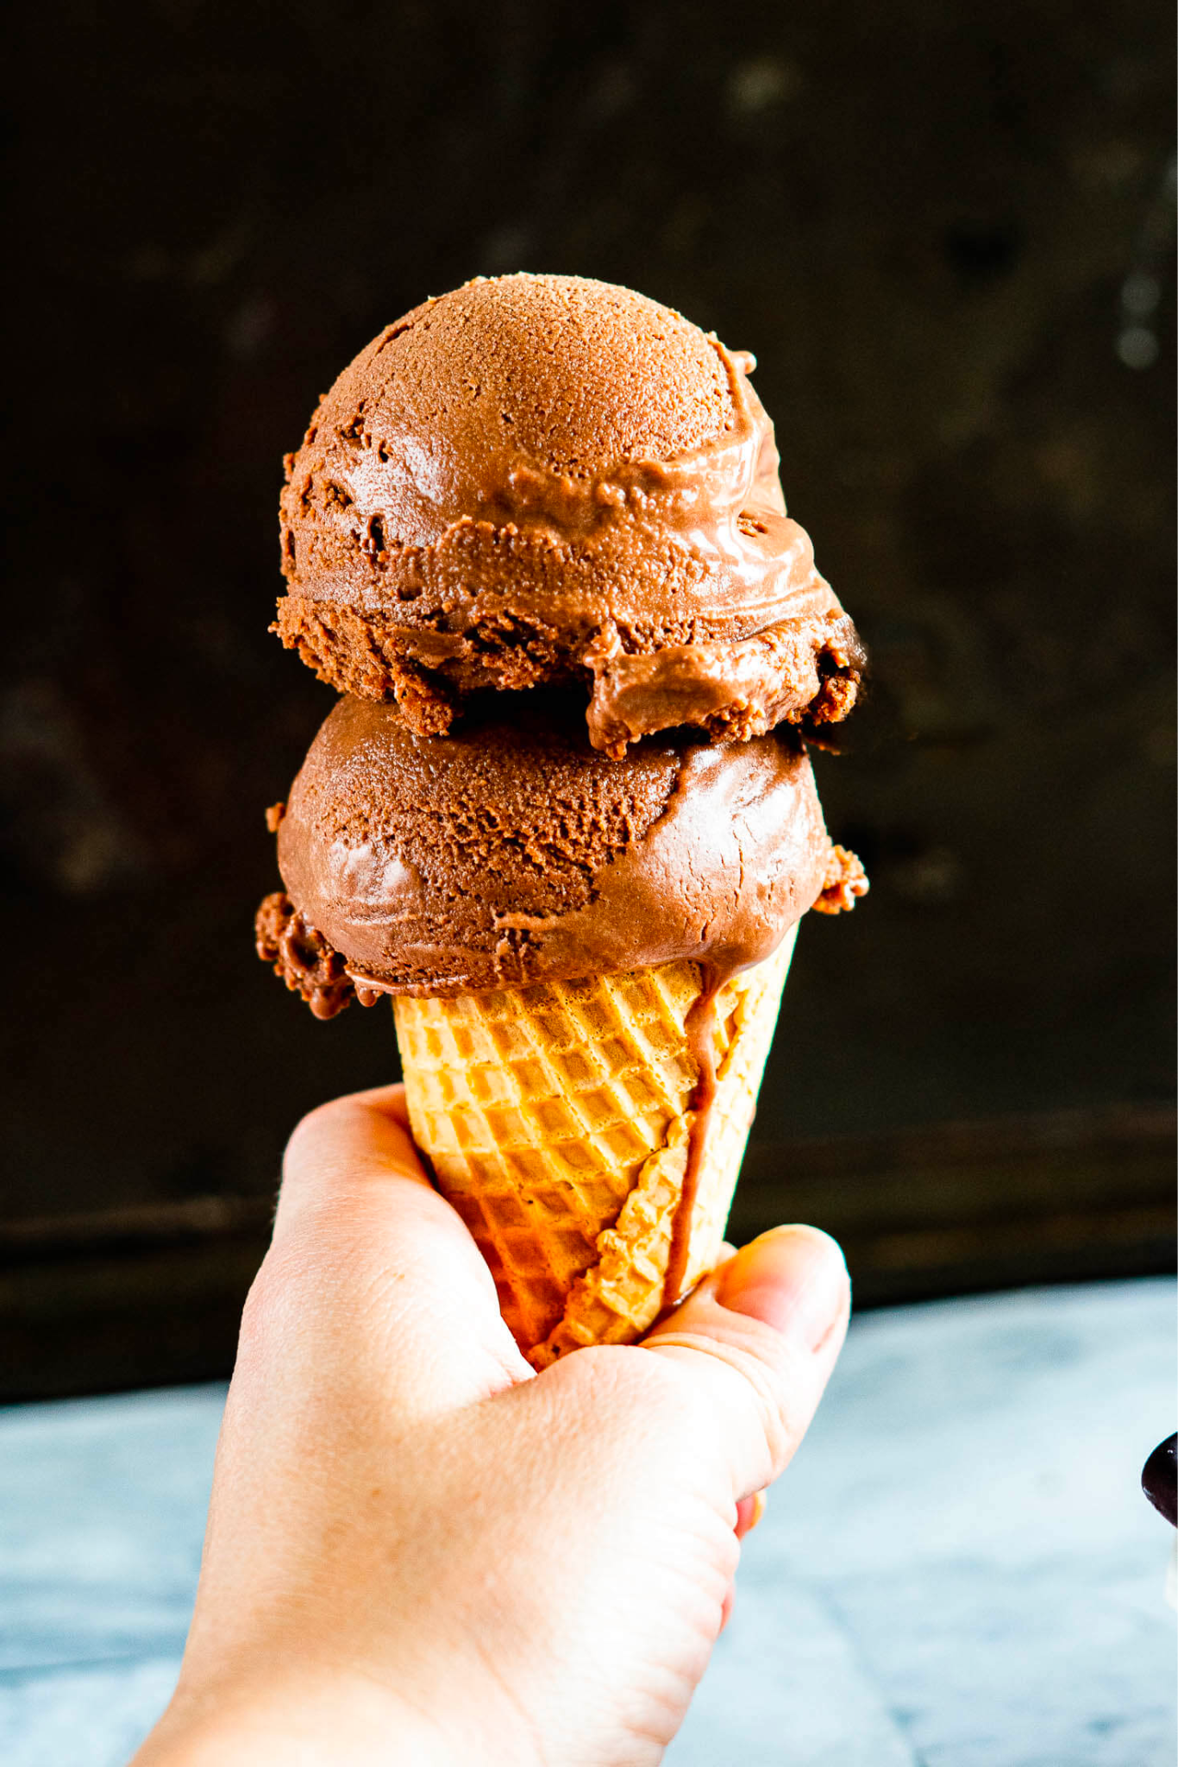
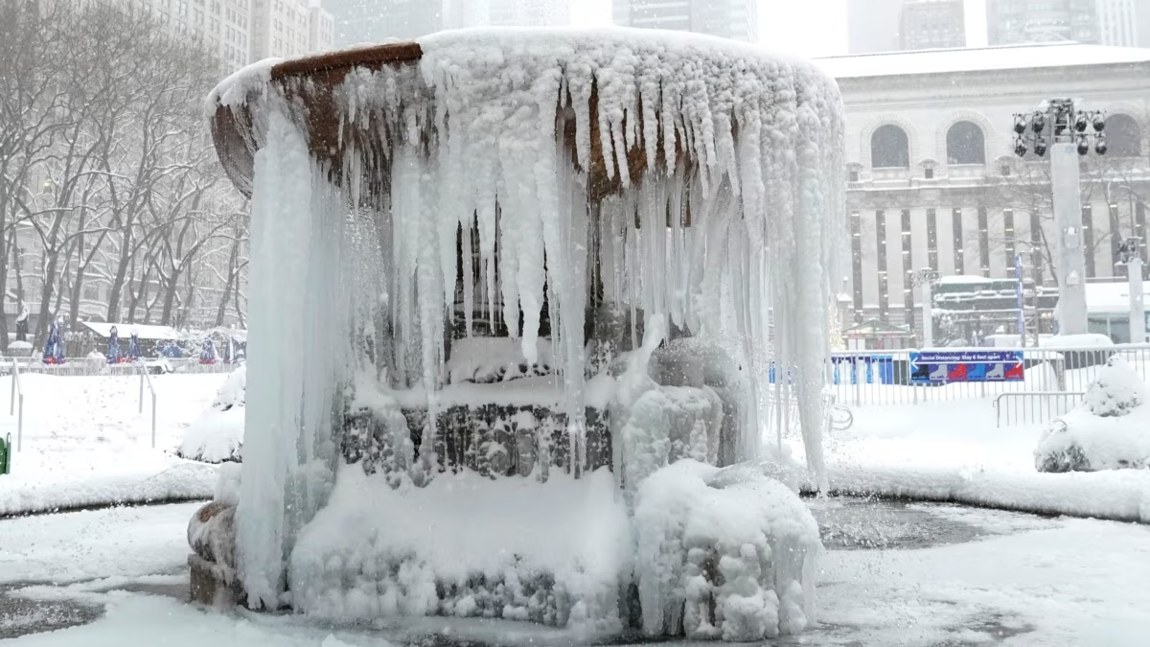
cì
次
lěng 冷
tiān qì hěn lěng 天气很冷。
bīng 冰
bīng qí lín 冰淇淋
liáng 凉
liáng kuài 凉快
pinyin | radical | meaning
bīng | 冫
ice
dòng 冻
lěng dòng 冷 冻
Notes:
Need to add a few words of 次- 第一次，每一次，...etc

Slide 5
海hǎi
冰bīng

Slide 6
冫
氵/水
次
河
沙
冻

Slide 7
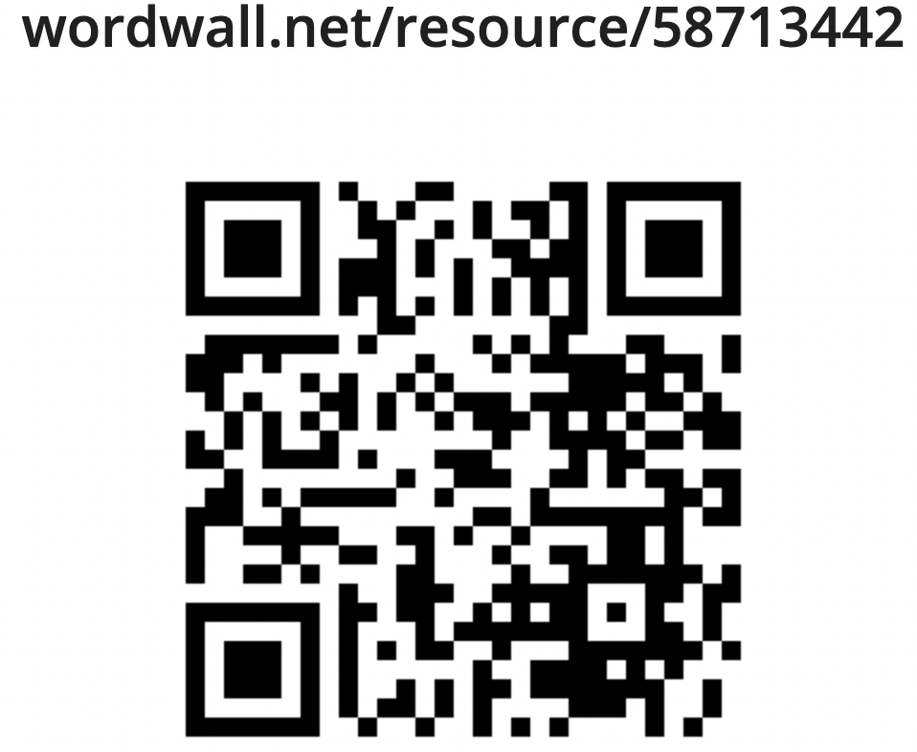
Whack a mole
https://wordwall.net/resource/58713442
Notes:
after the game, tie it back to text. to scan ‘次“ in 林丹 and 科比 的文本

Slide 8
Categorize the characters in the box below by writing the characters based on the radicals “冫” and “氵”.
河 冰 海 凉 冷 湖 沙 漠 冻 流 洗 溪 次
冫 | 氵

Slide 9
Look for characters with the radical 冫. Then use the characters you to make a phrase/sentence.
Make a phrase/sentence:
_____________________________________
冫
Make a phrase/sentence:
_____________________________________
Make a phrase/sentence:
_____________________________________
Make a phrase/sentence:
_____________________________________

Slide 10
Categorize the characters in the box below by writing the characters based on the radicals “ ” and “东”.
陈 拣 炼 冻 练 冻
 | 东

Slide 11
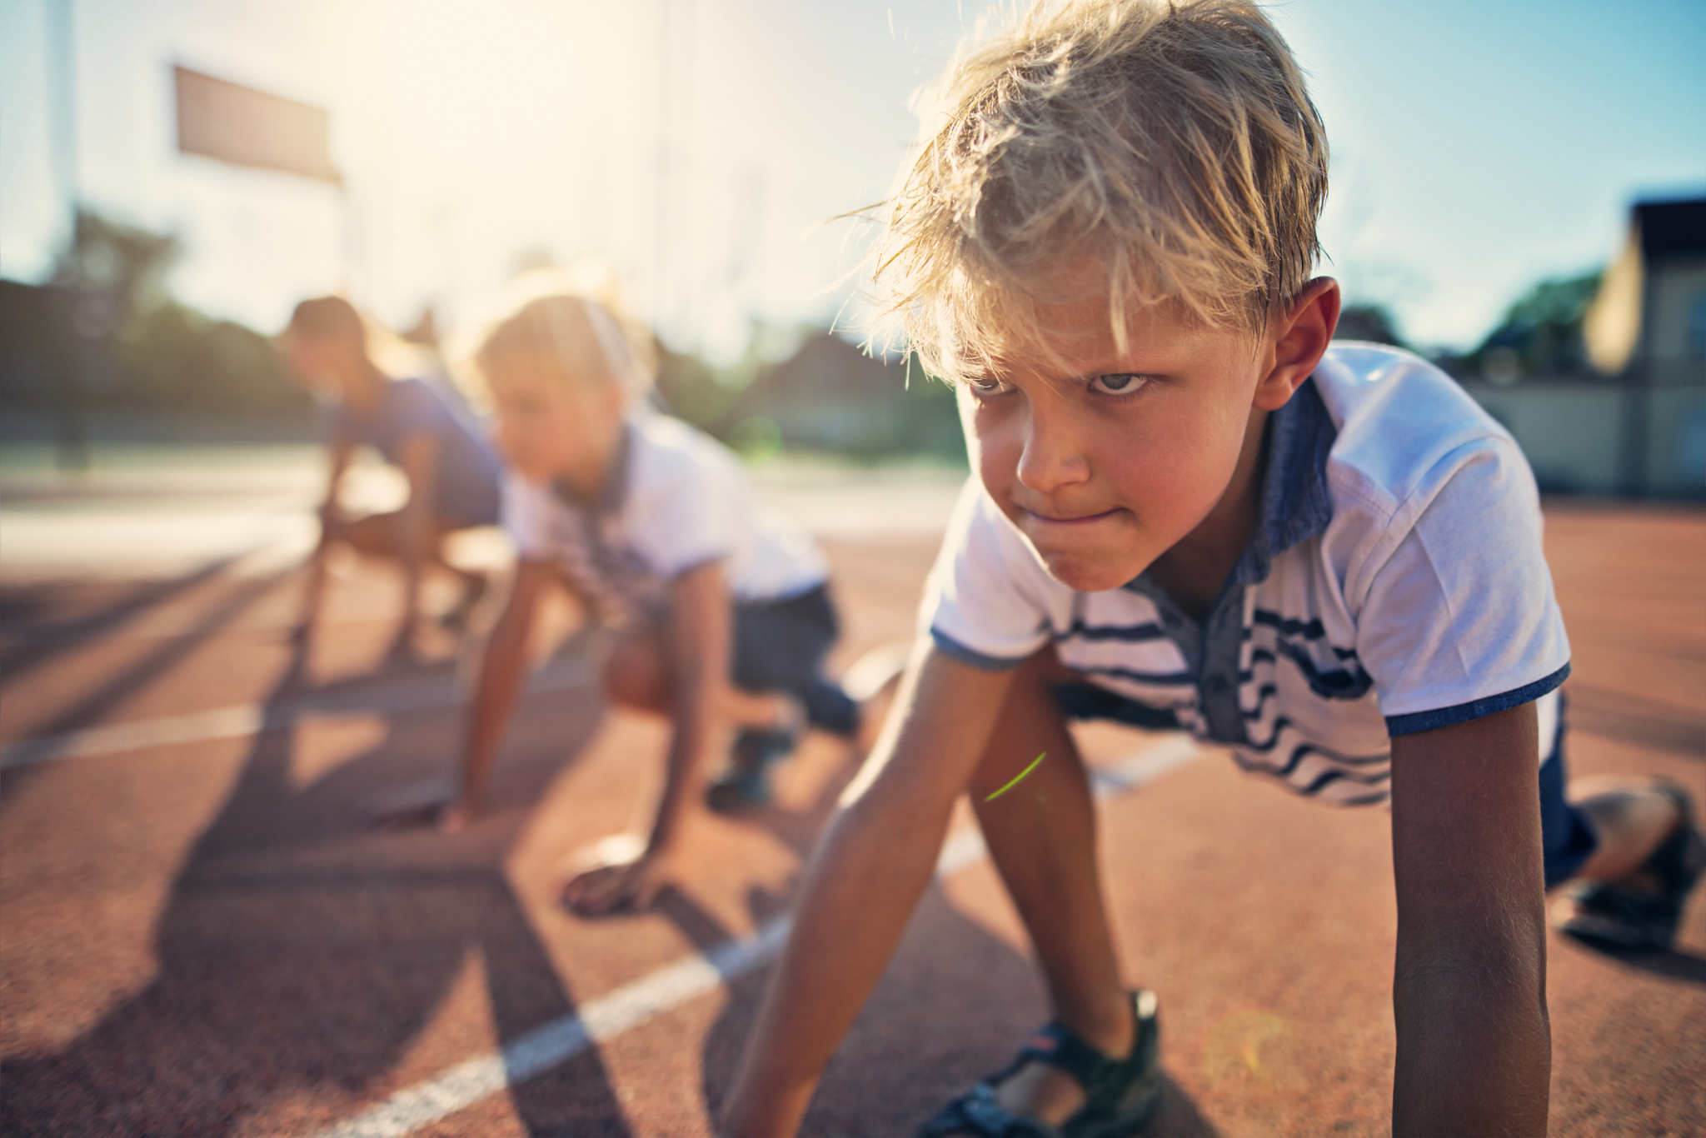
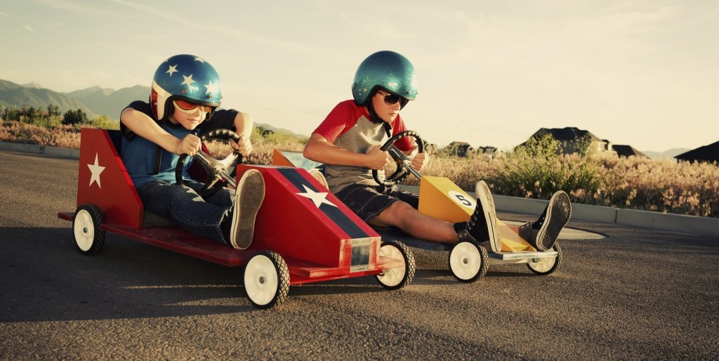
bǐ sài
比赛

Slide 12
Use different colors to identify the components.赛
Think - Pair - Share
sài
Notes:
animation speed should be slowed down.

Slide 13
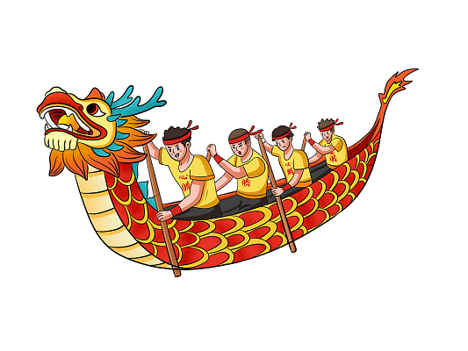
Use 赛+ __ to form Compound words.
Use the pictures below as a reference.
马mǎ
赛
龙舟lóngzhōu
车chē
e.g.赛跑
跑pǎo

Slide 14
Fill in the blanks to complete sentences using the words provided.
Work in pairs.
每年端午节(duānwǔjié)，我最喜欢看_______________。
爸爸开车开得很快，他非常喜欢_________。
爷爷喜欢马，他常常看_________。
弟弟跑得很快，所以他经常____________。
赛车 赛跑 赛龙舟 赛马

Slide 15
赢 yíng, win
Use different colors to identify the components.
yíng

Slide 16
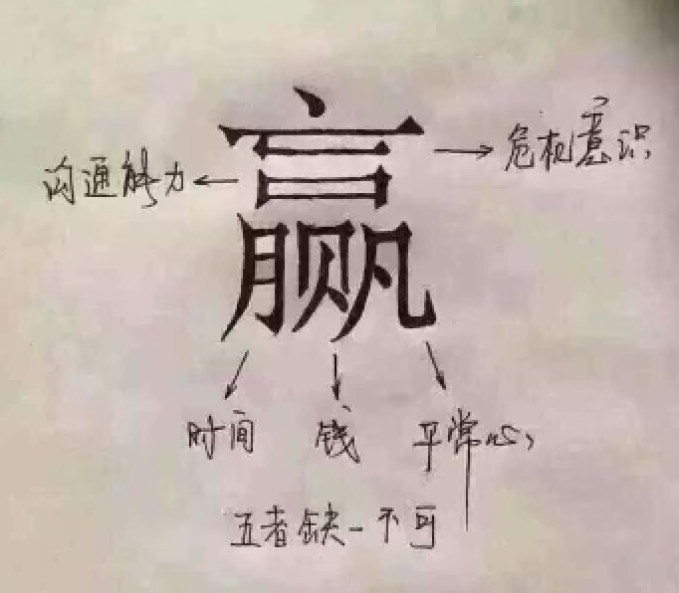
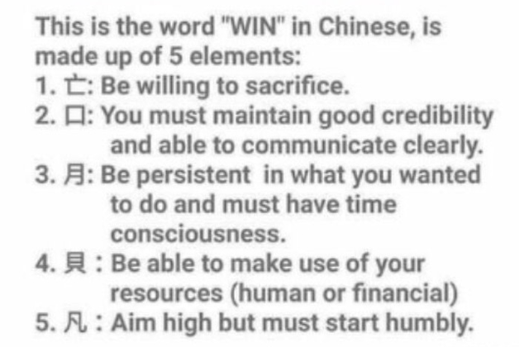
赢 yíng, win 有几个部件？你可以说出几个部件名？

Slide 17
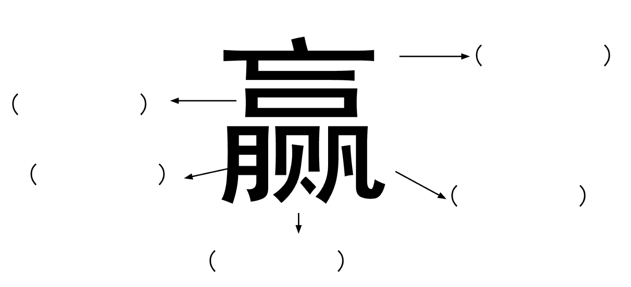
Write down the components and their meaning.
赢=( )+( )+( )+( )+( )

Slide 18
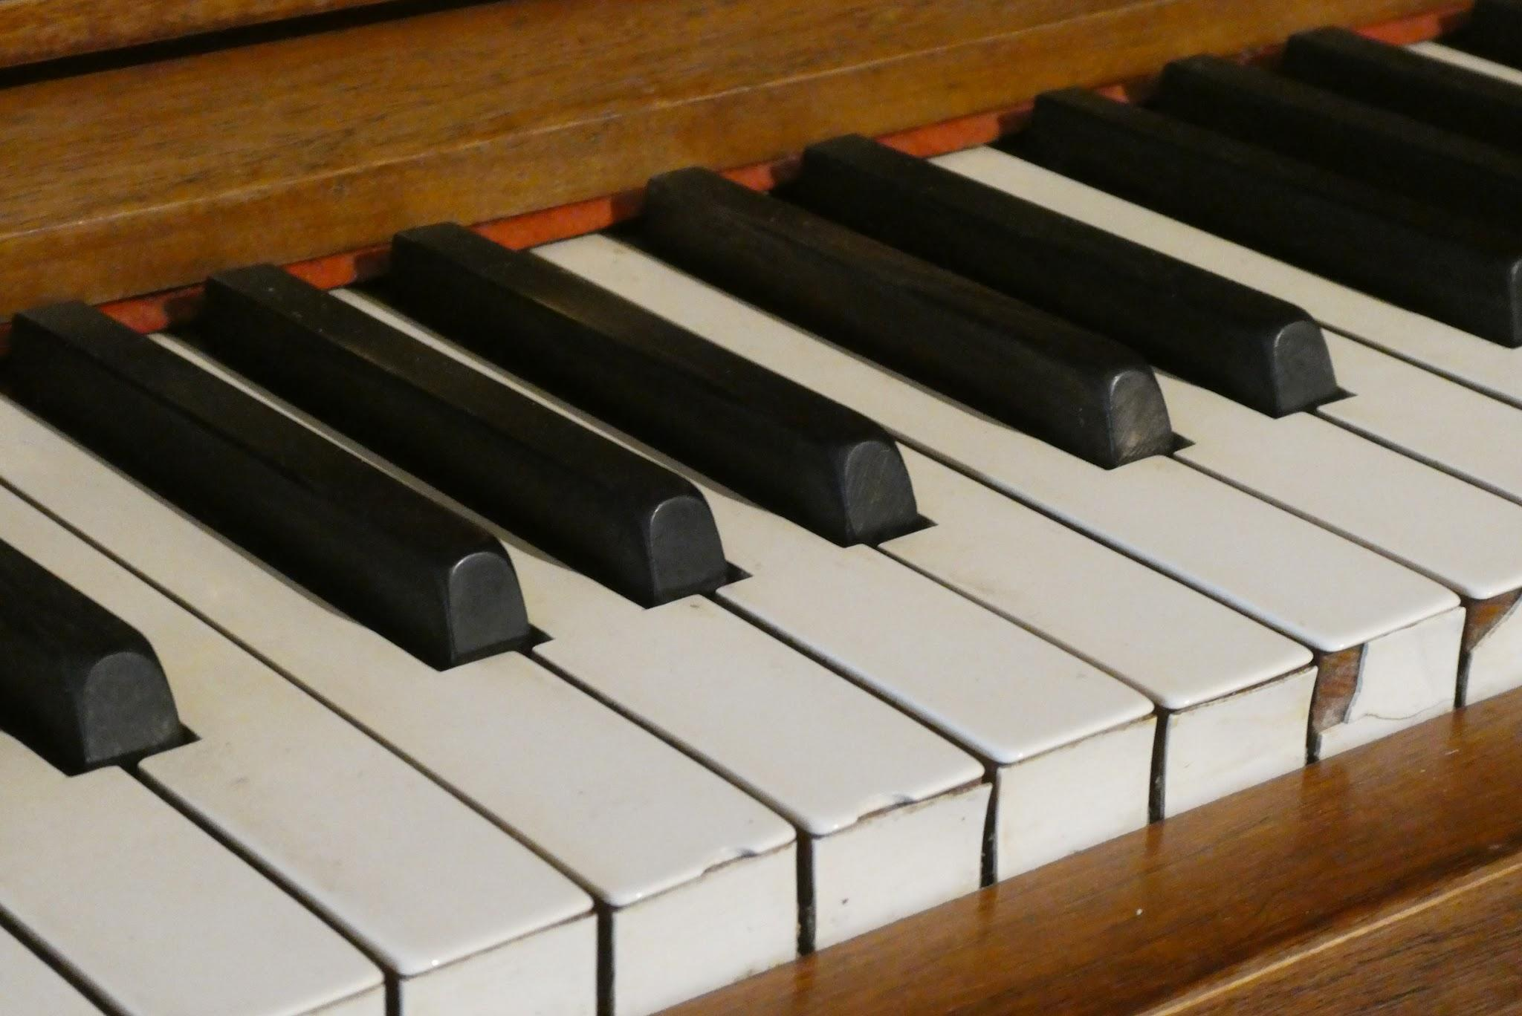
Infer the meaning of unknow words by using the clues：
Please try to figure out the meaning of “电子琴”, by using the following clues
电子(dianzi)means + 琴(qín)means
电子琴 means（ ）
Please try to figure out the meaning of “体校”, by using the following clues
体育(tǐyù)means + 学校(xuéxiào)means
体校 means（ ）

Slide 19
Use the known words to guess the meaning of the words below
 | My guess | Write the correct meaning using an on-line dictionary.
天 + 黑 = 天黑
排(pái, to line up) + 名= 排名
有 + 名 = 有名
全(quán,whole) + 国 = 全国

Slide 20
Fill in the blanks with the words (天黑、排名、有名、全国) to complete the sentences.
他是一位非常________的老师，________都知道他的名字。
他现在的________是第三名，他的目标(mùbiāo, goal)是第一名。
________了，我看不到路(lù,road)回家。

Slide 21
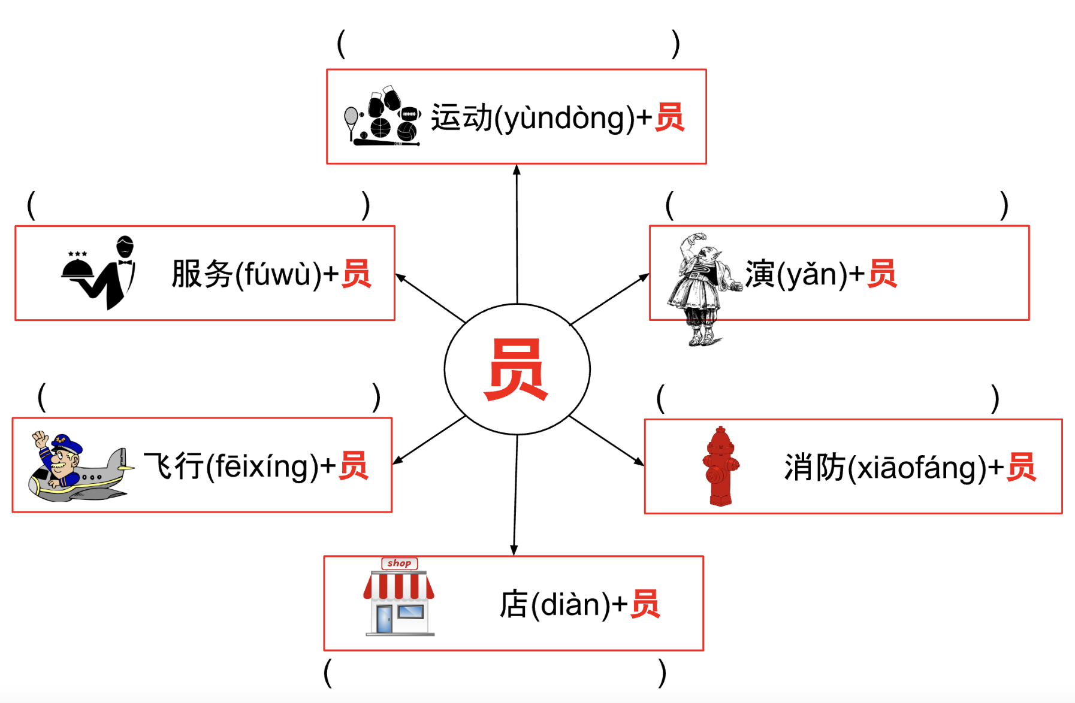
Review 员(yuán, person)：扩词练习

Slide 22
Fill in the blanks to complete the sentences using the words above.
我的爸爸是一位________员，他经常去不同的国家旅行。
弟弟是一位________员。他每天都去学校打篮球。
这家面包店的________员非常亲切(qīnqiè,nice)，所以我很喜欢去。

Slide 23
Formative Assessment 2: Interpretive
Students read the information on the unmodified reading materials (posters) and then use the reading skills(scan for keywords, activate lexical inferencing skill) to answer questions.
Question: What country does 羽生结弦 represent? (multiple choices) A. China B. Japan C. USA D. South Korea
Notes:
http://sports.news.cn/c/2022-03/17/c_1128479752.htm

Slide 24
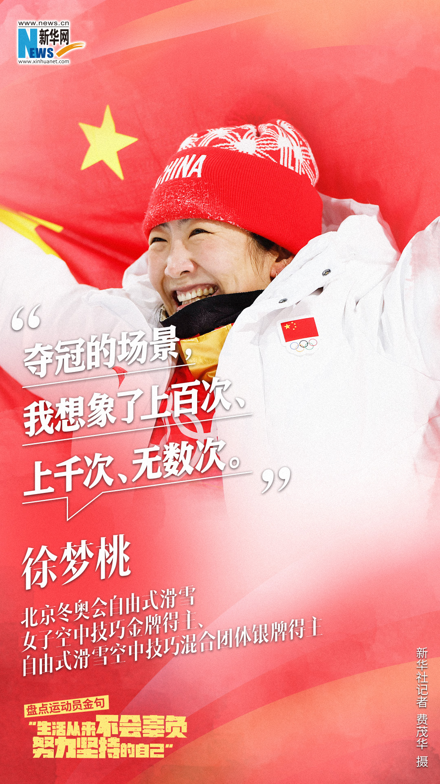
Formative Assessment 2: Interpretive
Students read the information on the unmodified reading materials (posters) and then use the reading skills(scan for keywords, activate lexical inferencing skill) to answer questions.
Question: How many times has 徐梦桃 dreamed about the championship? (multiple choices) A. many many times B. ten times C. hundreds of times D. thousands of times
Notes:
http://sports.news.cn/c/2022-03/17/c_1128479752.htm

Slide 25
Formative Assessment 2: Interpretive
Students read the information on the unmodified reading materials (posters) and then use the reading skills(scan for keywords, activate lexical inferencing skill) to answer questions.
Question: 她是哪国人？
How many times has she participated in Olympic?
Notes:
http://sports.news.cn/c/2022-03/17/c_1128479752.htm

Slide 26
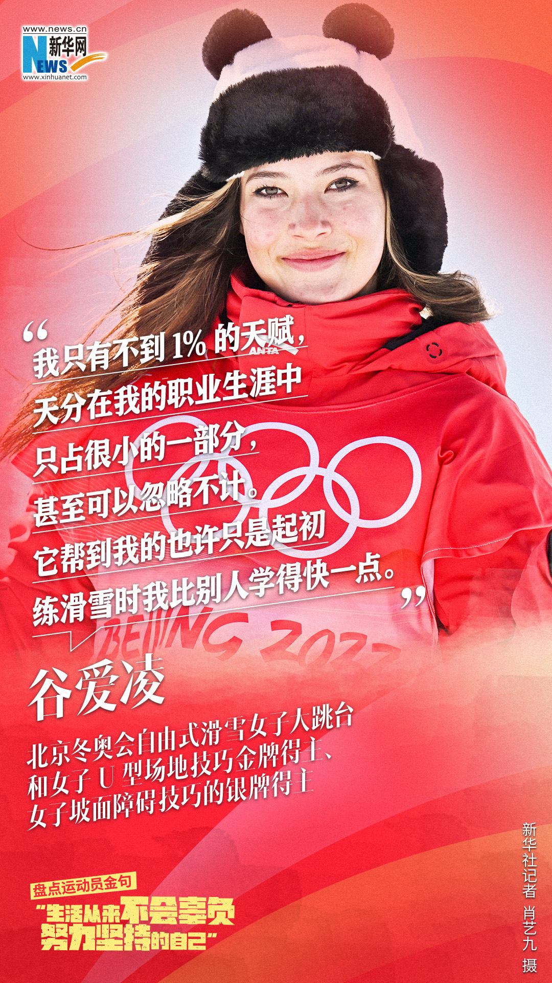
Formative Assessment 2: Interpretive
Students read the information on the unmodified reading materials (posters) and then use the reading skills(scan for keywords, activate lexical inferencing skill) to answer questions.
Question: Circle the character “练” in the poster。
What does “练滑雪” mean?
你看过她比赛吗？
你知道她多大吗？
你喜欢她吗？
Notes:
http://sports.news.cn/c/2022-03/17/c_1128479752.htm

